Slide 1
Software Development Tracker
By
Vijay Anand Pandian
Sai Charan
Srujan
Javeed Mohammad

Slide 2
Introduction
This application helps the organization or project manager track the development progress of the software they are developing.
Scope
The scope of the project is as follows:
• To build an application through which users can create a new account.
• The user shall log in to their account to check the user stories assigned to them.
• The user shall create a Kanban board for their project.
• The user(admin) shall add a project member who can access the Kanban board.
• The user shall create a new task or issue or card about particular user stories or requirements.
• The user shall update the status or progress of the particular user story.

Slide 3
Application Functionalities
User can create(register) an account on the application.
User can Login and logout of the application.
User can create a project or can be a member of a project.
Project-admin can add members(users) to a project.
Project-admin and members can create task(user-stories) and assign it to other users.
Tasks are given a type which indicates the type of the user-story(i.e. task, issue, bug etc.)
Tasks are given a status which indicates the progress of the user-story.

Slide 4
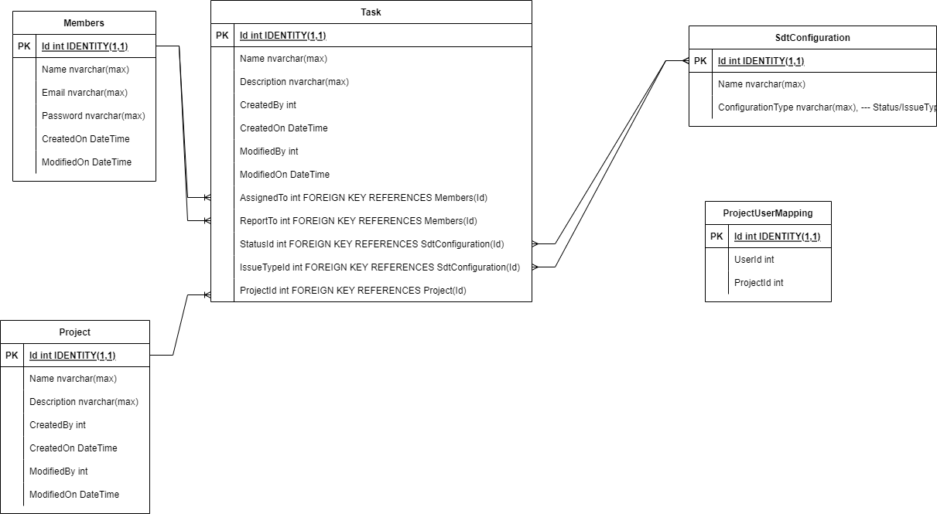
Database Models : ER Diagram

Slide 5
DEMO
Demo video Link: https://youtu.be/lH5uW-G49HY

Slide 6
Thank You…!

